Slide 1

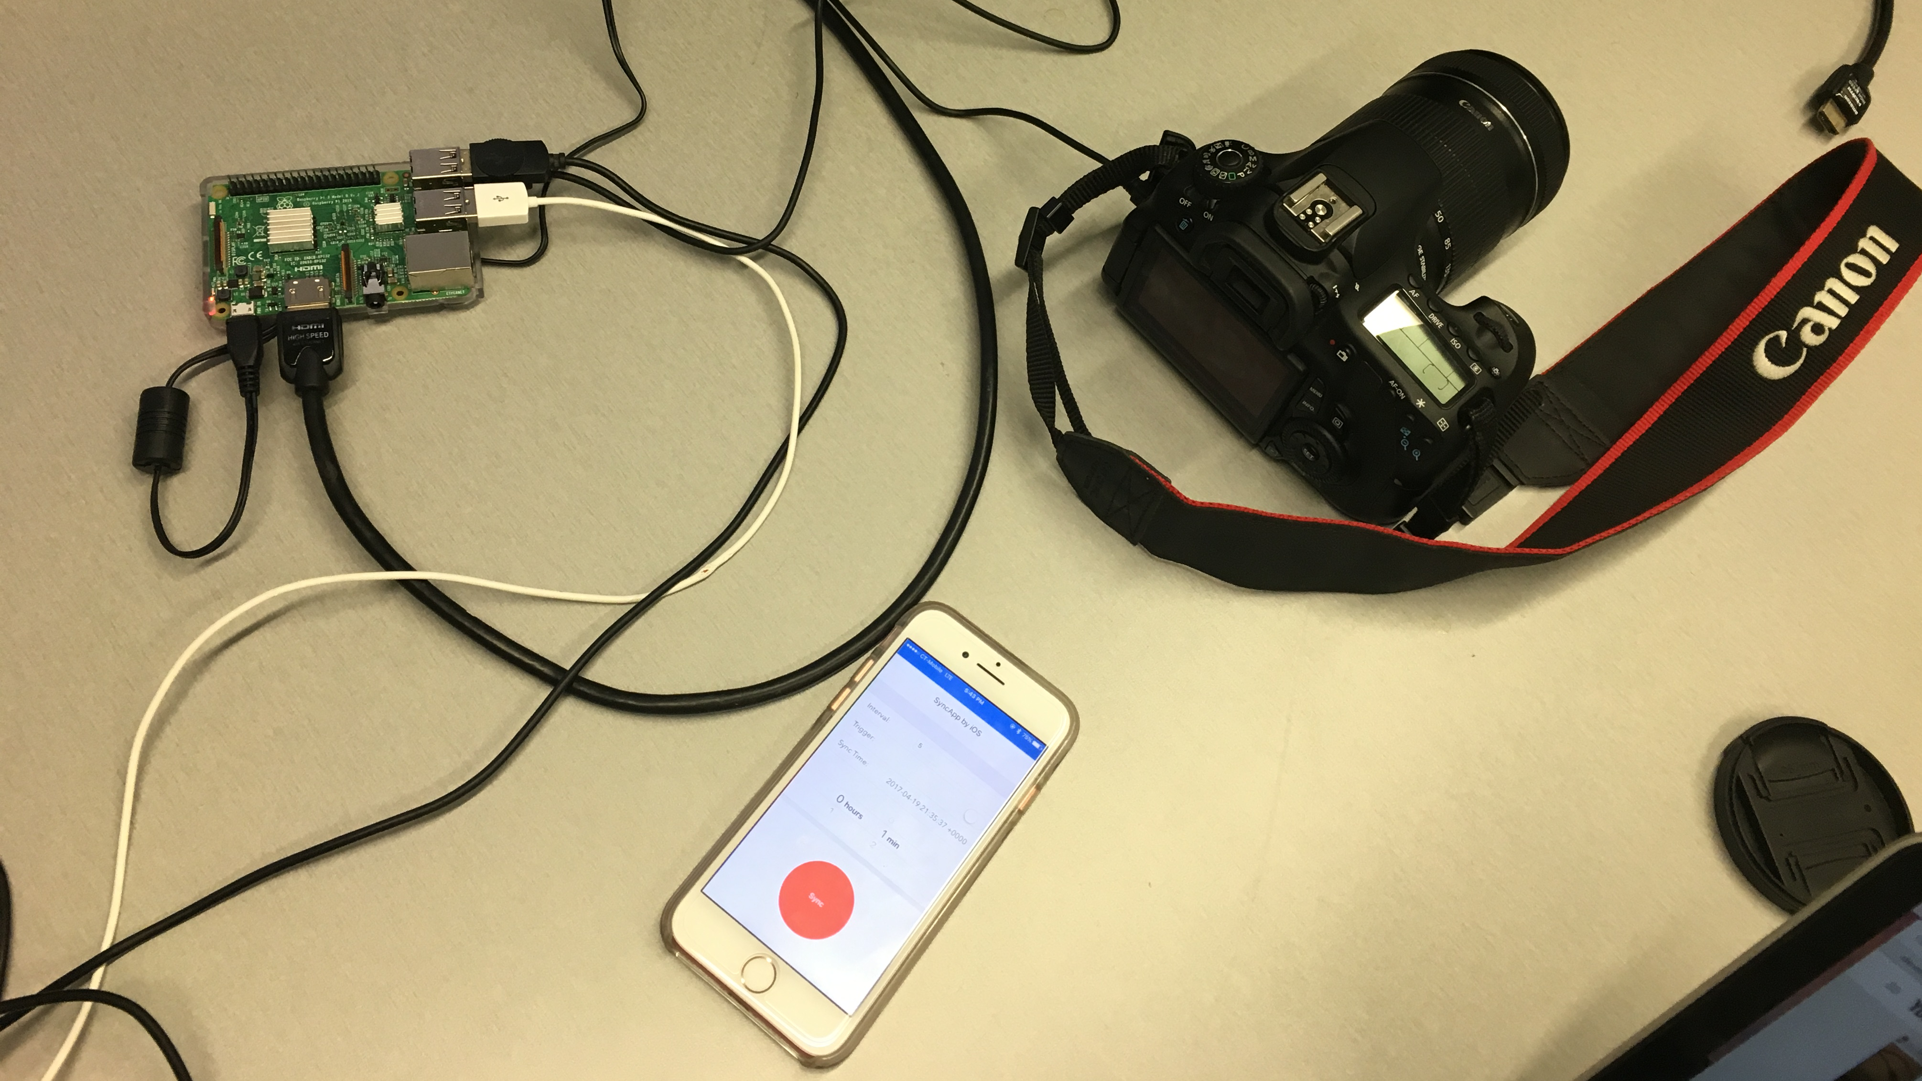

using iOS app to do self-defined lapse shooting
Jing Si
jingsi@gwu.edu

Slide 2
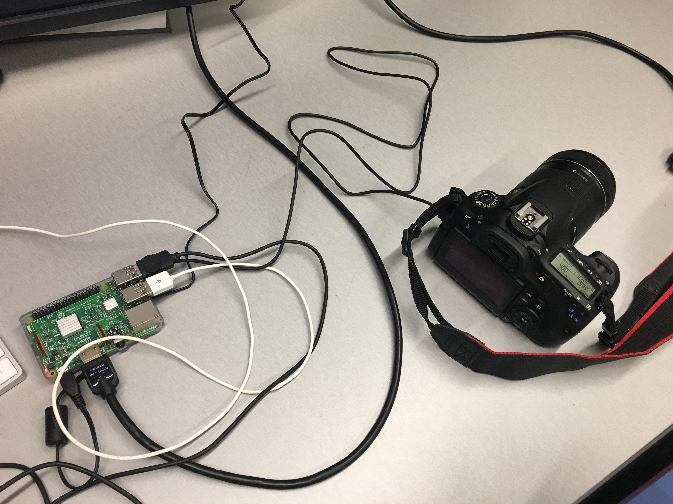
Part 1 camera & raspberry set up
Assembly the basic parts
Using an USB cable to connect the camera and the raspberry pi

Slide 3
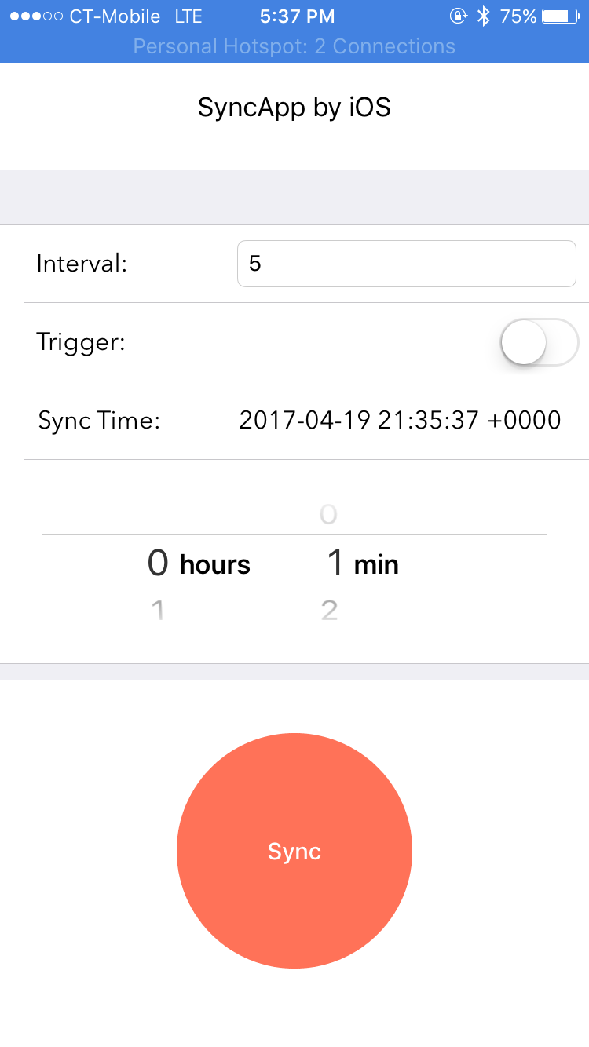
part 2 develop an iOS app
this app is used to control the shooting process
The interval is the sleep time between two pictures
The time wheel is to set the entire time of the process, and the longest time would be 12hs and 59mins
When the trigger is ON, the process will began, at this time, user can change the variables as they want, and will not break the process.
The app intend to change more variables, however, they haven’t been added.

Slide 4
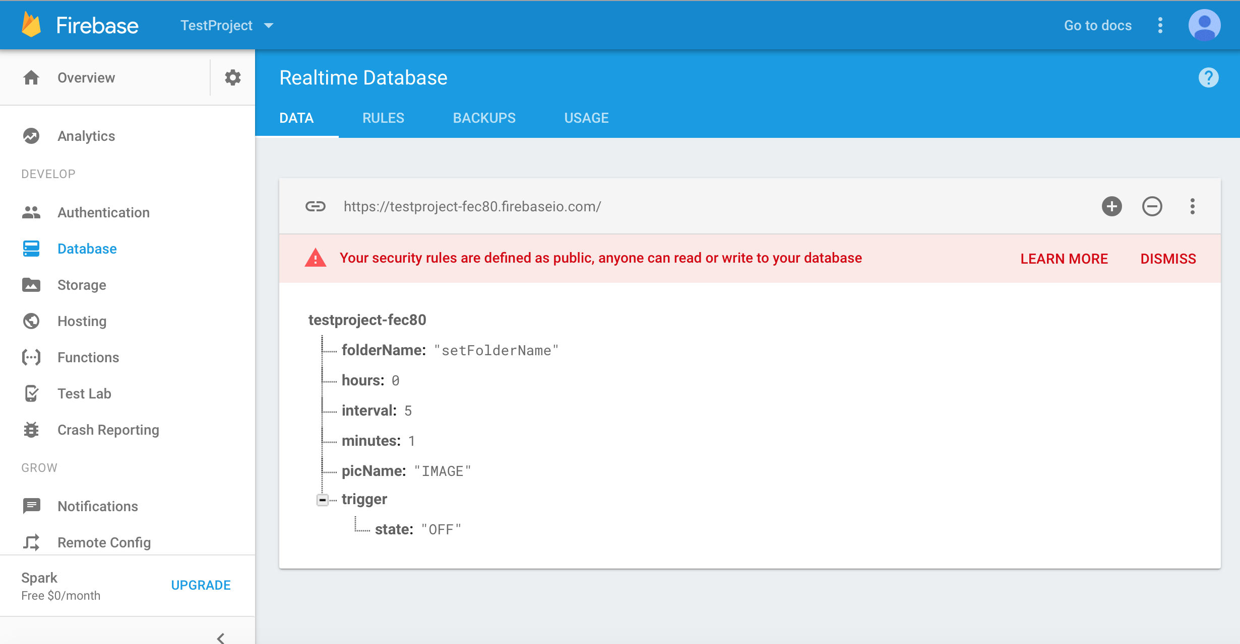
Real-time database
Using Google's real time database Firebase
User can change parameters at any time during the shooting process
without breaking the process

Slide 5
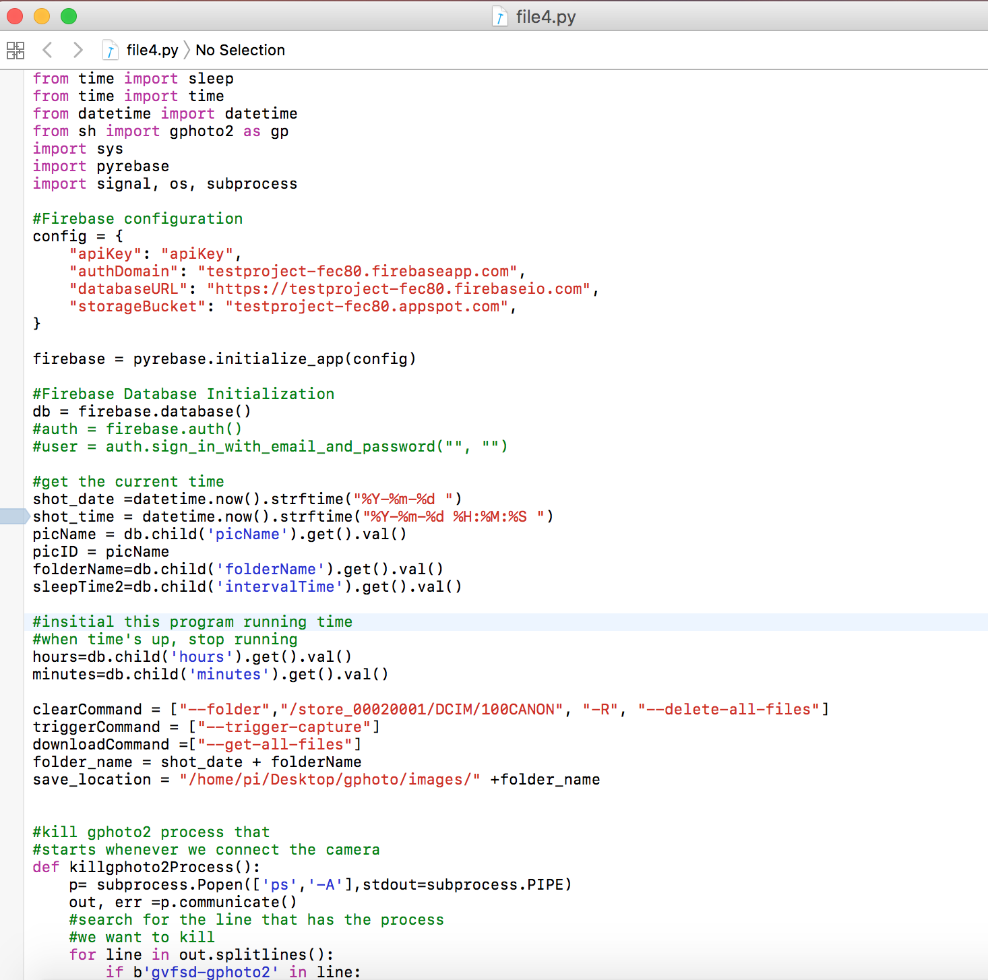
Part 3 raspberry as controller
Using gphoto2 to control the trigger and manage the photos
Like, trigger capture, download photos from camera to local directory
Create new folder and rename the photo by users

Slide 6
steps
Configuration of Firebase: so that the raspberry pi could access the DATA in Firebase
Obtain from DATA of Firebase
If the variable ”trigger” says ON, start the shooting process, or if “OFF” end this process
Download pictures from camera to local computer a

Slide 7
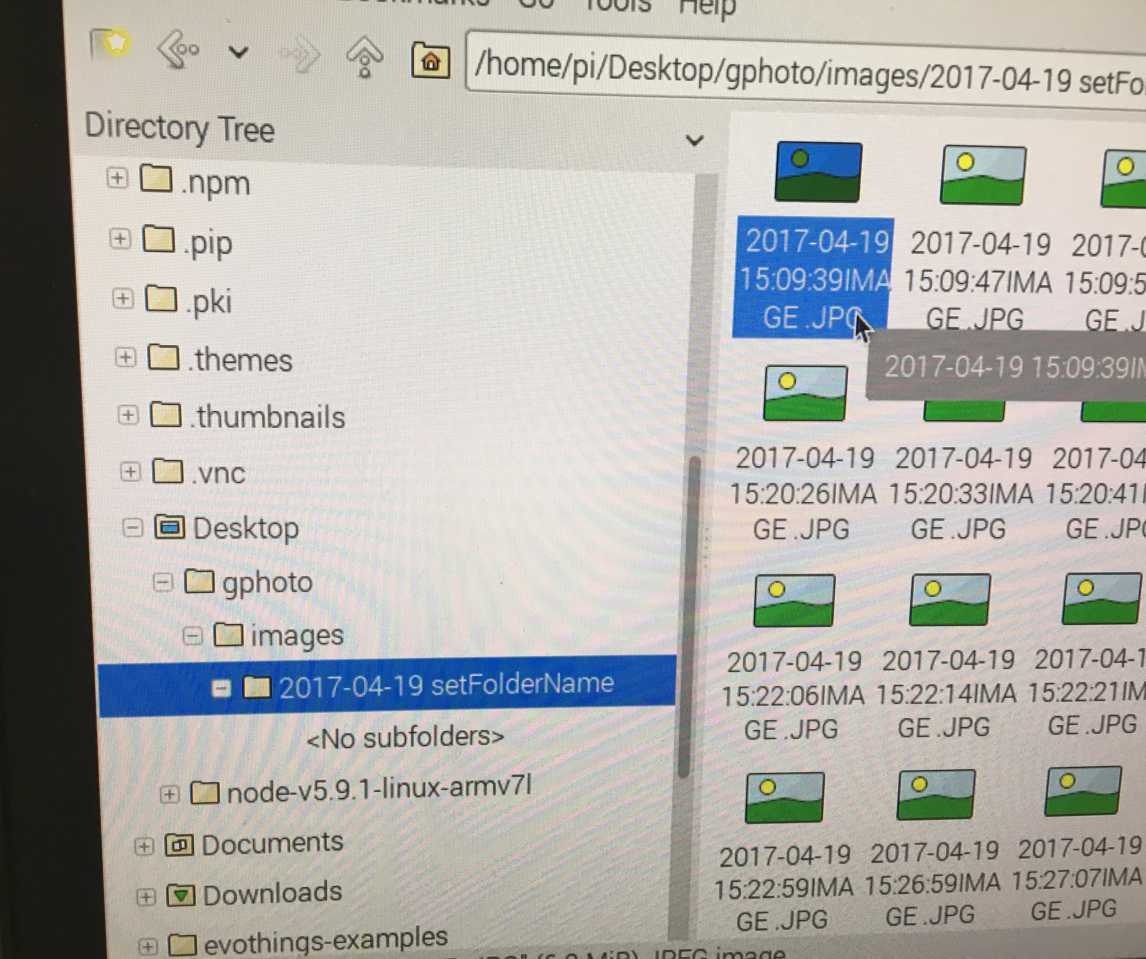
Steps
User could create a new folder or use the default one
Download pictures from camera to local computer, and user also rename these pictures.

Slide 8
advantage
All the data is real time, so if the user want to change some variables during the process, he do not need to end the process.
For example, if the lights become dark, user could extend the exposure time during the shooting period.

